Slide 1
Short Messaging Control Mechanism for CAN Bus Architecture
EE 6900 – Software Defined Radio and IoT
Andrew Cline, Clifford Gilbert, Goran Novakovic
April 15, 2024

Slide 2
Project Introduction
SDR is an effective way to create broad range communication that can be adjusted and modified to suit the needs of any project.
Since a lot of devices in the modern world communicate over some BUS style network the use of SDR can improve the communication for noncrucial and yet important data transferring over longer distances.
Objective for this project was to simulate a CAN BUS network and a SDR communication channel to explore the feasibility of the potential data transferring with additional security features.

Slide 3
Short Literature Review
[1] Vehicular VLC using SDR and Exploiting Vehicles CAN Bus
Project uses SDR to convert CAN bus messages to signals.
Visible Light Communications (VLC) are used to transport the data through LEDs from one vehicle to the other.
VLC platform using SDRs is very promising given the large bandwidth available and existing LED technology.
[7] Using SDRs to Prototype and Deploy Vehicular Networking for AVs
Article discusses utilizing SDRs for development of autonomous vehicles (AVs).
Flexible framework of SDRs allow for wide tuning ranges, compatibility of open-source tools, and implementation of multiple frequency protocols.
Vehicle-to-Vehicle communication allow for swarm awareness.
While current problems exist with local positioning in rural areas, SDRs can provide a multipath for relaying data from Vehicle-to-Computer.

Slide 4
Methodology
Using a standard CAN BUS module from the Simulink Vehicle Network Toolbox, standard CAN BUS frame is 8 bytes in length. The input array represents the normal CAN BUS signal.
Once the can bus packages and sends out the message into the SDR, the CAN BUS message will then be transmitted using Binary Phase-shift keying (BPSK).
Once the transmission happens the model introduces some simulated noise to emulate some loss of signal quality/clarity and then the signal is decoded back to the original CAN BUS message signal.

Slide 5
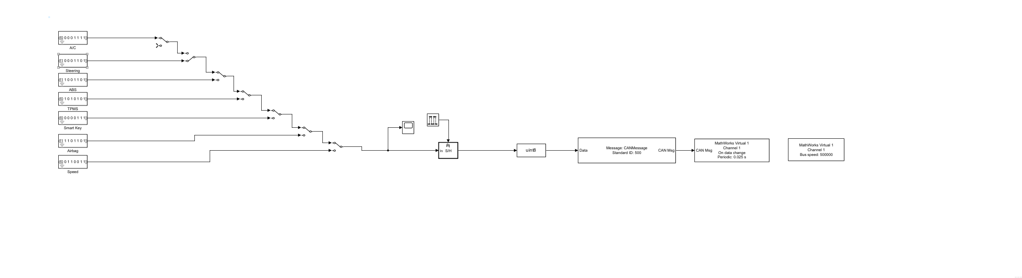
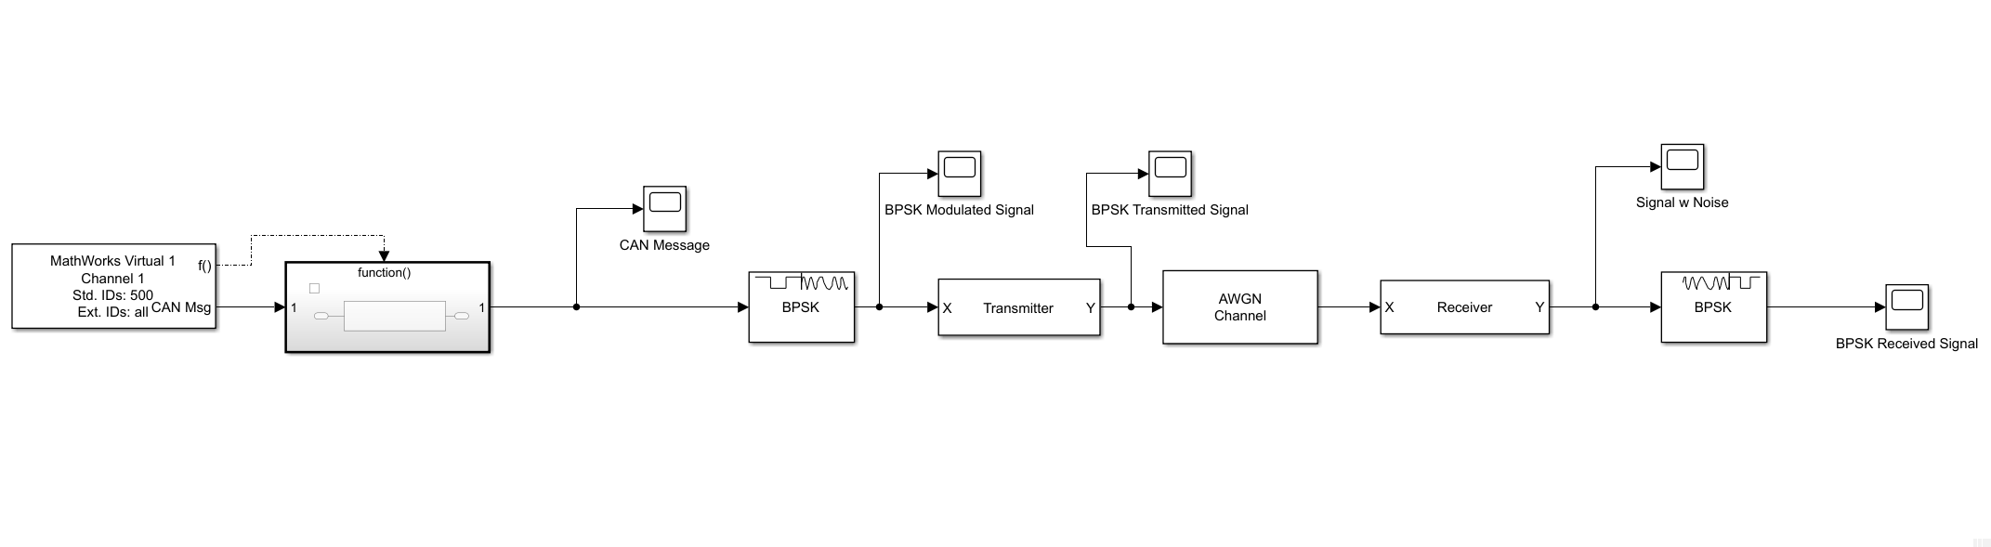
Simulink Model - Demonstration
Input is one 8-bit entry
Each bit transmitted for 5 seconds (Frequency = 0.2 Hz)

Slide 6
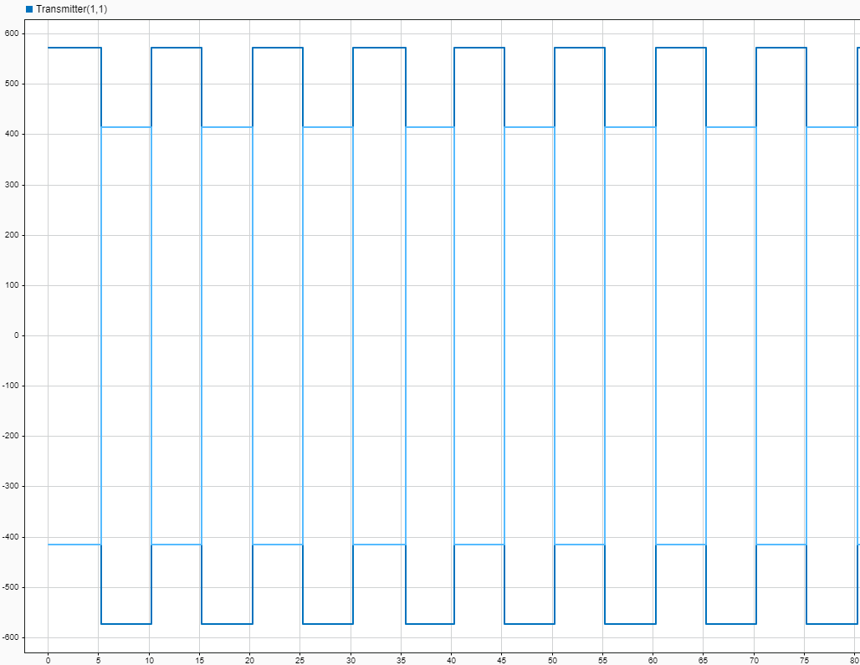
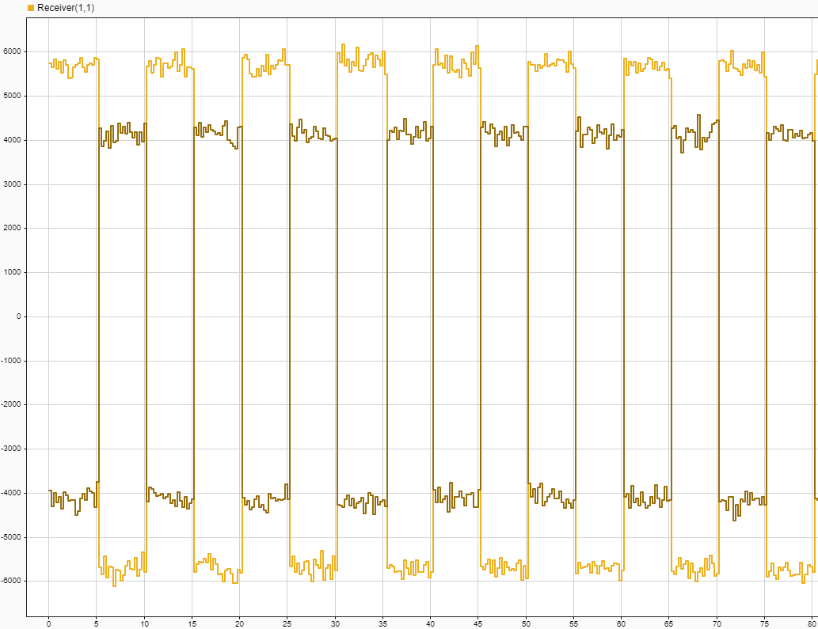
Simulink Model - Results
All 7 of our 8-bit input test cases were successfully received
Examples of the Transmitted (Left) and Received (Right) Signals

Slide 7
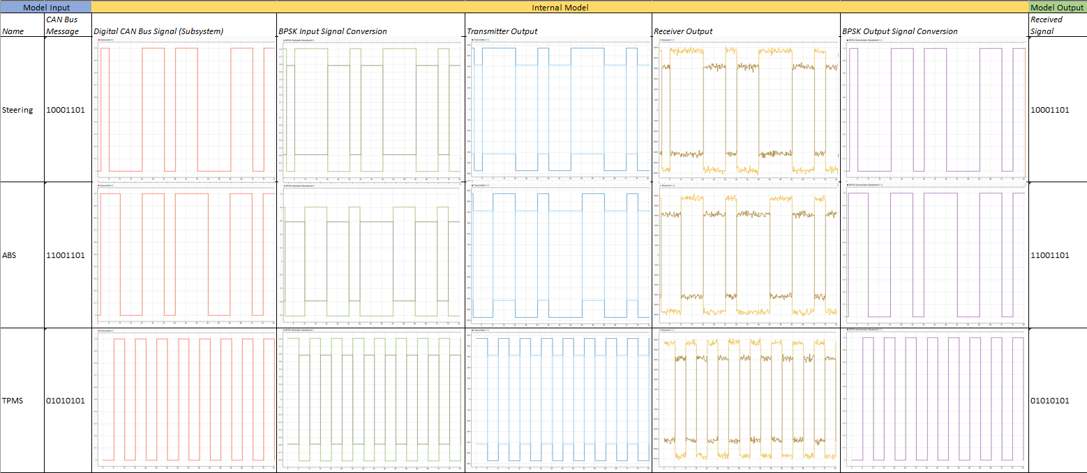
Test Case Matrix

Slide 8
Discussion
Limitations of this project concept is clearly the fact that SDR frequencies need to be selected such that no interferences or cross talking may occur during transmission.
Another limitation is the OEMs data presentation on the BUS as each manufacturer creates unique messages thus creating a massive data base need to interpret the messages and translate them appropriately for the needs.
In the future, our model would need to be tested in multiple environments to determine the effective signal processing required in each scenario.

Slide 9
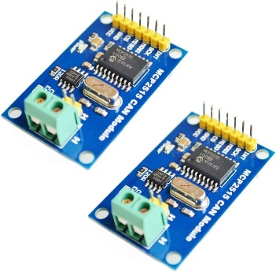
Conclusion
Simulink Model proves the concept of using SDR to transmit CAN bus data is viable for the automotive industry.
Future direction of the project would potentially include the use of a SDR transmission and a CAN BUS module to generate traffic. TJA1050 is inexpensive and will serve the purpose of generating CAN BUS traffic that the SDR Device then can decode and transmit.
Further environmental considerations need to be addressed as far as noise and continuous CAN bus signals.

Slide 10
Acknowledgments
Researchers from University of Chile for their fundamental work on a VLC platform using SDRs for V2V communication. [1]
Vicente Matus
Nicolas Maturana
Cesar A. Azurdia-Meza
Samuel Montejo-Sanchez
Javier Rojas
Clifford Gilbert – Simulink Modeling, Research material
Andrew Cline – Simulink Modeling, Research material
Goran Novakovic – Simulink Modeling, Idea implementation

Slide 11
References
[1] Matus, Vicente & Maturana, Npossible,, Azurdia-Meza, Cesar & Montejo Sánchez, Samuel & Rojas, Javier. (2017). Hardware Design of a Prototyping Platform for Vehicular VLC Using SDR and Exploiting Vehicles CAN Bus. 10.1109/SACVLC.2017.8267606.
[2] Design and Create a Custom Block - Matlab & Simulink, www.mathworks.com/help/simulink/ug/tutorial-creating-a-custom-block.html. Accessed 4 Mar. 2024.
[3] Frenzel, Lou. “Understanding Modern Digital Modulation Techniques.” Electronic Design, Electronic Design, 12 Jan. 2023, www.electronicdesign.com/technologies/communications/article/21798737/electronic-design-understanding-modern-digital-modulation-techniques.
[4] “Data Encryption Methods & Types: Beginner’s Guide to Encryption.” Splunk, www.splunk.com/en_us/blog/learn/data-encryption-methods-types.html. Accessed 4 Mar. 2024.
[5] “Phased Array System Toolbox — Blocks.” Reference List - MATLAB & Simulink, www.mathworks.com/help/phased/referencelist.html?type=block&s_tid=CRUX_topnav. Accessed 4 Mar. 2024.
[6] “BPSK Demodulator Baseband.” Modulate Using BPSK Method - Simulink, www.mathworks.com/help/comm/ref/bpskmodulatorbaseband.html. Accessed 21 Mar. 2024.
[7] “Build CAN Communication Simulink Models.” Build Can Communication Simulink Models - MATLAB & Simulink, www.mathworks.com/help/vnt/ug/build-can-communication-simulink-models.html. Accessed 11 Mar. 2024.
[8] McHugh, Brendon. “SDRs to Deploy Vehicular Networking for AVs.” EE Times Europe, 31 Aug. 2022, www.eetimes.eu/using-sdrs-to-prototype-and-deploy-vehicular-networking-for-avs/.

Slide 12
Additional Materials
Github Repository: https://github.com/cgilbert43/SDR_KSU

